Slide 1
Port Moody Secondary Graduating Class of 2024
March Assembly
Notes:
NOTE:
To change the image on this slide, select the picture and delete it. Then click the Pictures icon in the placeholder to insert your own image.

Slide 2
Before We Begin…
Information shared today is a general preview. More to come!
A Grad Planning document will be sent to all Gr. 12 students & families. No need to take pictures of the slides.
There will be additional assemblies and informational updates sent home over the coming weeks and months.

Slide 3
Graduation Expectations
Meeting all Graduation Requirements
If short requirements or key courses: You will need a Grad Plan coordinated through your counsellor
General expectations of students:
Now to June
Grad Activities
Dinner/Dance & After Grad

Slide 4
Have you…
Paid any outstanding fees (e.g. lost/damaged books, activity fee, graduation fee) and completed your policy form (on SchoolCashOnline)
Completed all assignments for CLC 12 (Career Life Connections). You must have done your exit interview
Returned any Sem 1 textbooks/library books that you still have
Returned any team/athletic uniforms

Slide 5
DINNER/DANCE and aftergrad

Slide 6
Meet your 2024 Grad Committee!!
Saiorse Borden
Daniel Canon
Aya Doulfikar
Cassandra Felton
Vienna Gabel
Bo Sung Kang
Ziyad Khan
Reena Nawar
Parnika Rawla

Slide 7
DINNER DANCE
Saturday, June 15, 2024, 5:30-11 pm
Pinnacle Hotel Vancouver Harbourfront
Theme to be Determined (voting will happen after the assembly)!!
Ticket price is $170 per person
Students may bring 1 (preapproved) guest to the event.
Tickets on sale beginning April 9, seating choices begin April 16*.
*All fees, CLC, uniforms, etc. must be dealt with to buy a ticket.

Slide 8
GUESTS
A guest is considered anyone who is not part of the PMSS Grade 12 graduating class.
All guests must be age appropriate (e.g. one year out of school).
All guests must be approved by school administration prior to purchasing a ticket.
Guest approval forms will be available online beginning April 2, and are due by 3:30 April 12. No late or incomplete applications will be considered.
Any approved guest tickets will be attached to the graduating student’s SchoolCashOnline account

Slide 9
Dinner Dance Themes—you will be voting for one of these starting later today
Cloud 9
Old Hollywood
Summer Solstice
Yule Ball

Slide 10
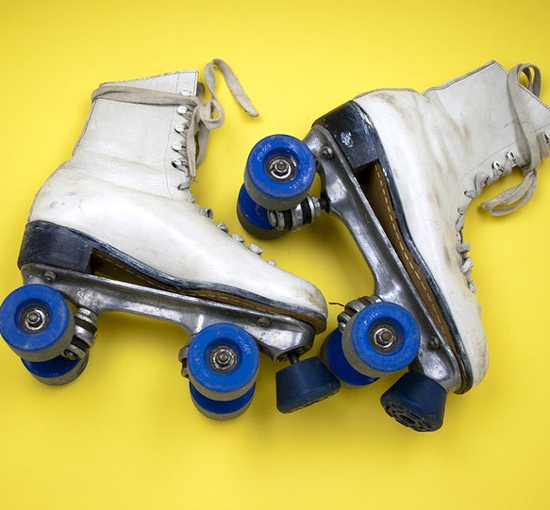
AFTER GRAD
Info TBA

Slide 11
COMMENCEMENT AND CO-VALEDICTORIAN NOMINATIONS

Slide 12
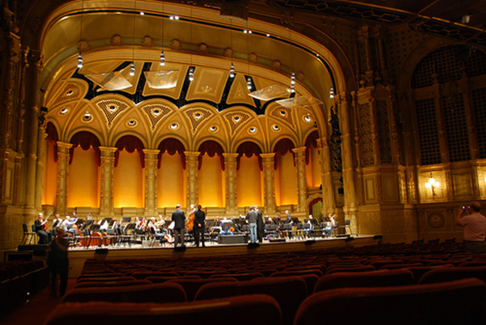
Commencement
Saturday, June 22, 2024
Orpheum Theatre
Start at 11:00 am, arrive at 10 am
You will be able to purchase tickets for your family to attend
Students will collect their Caps and Gowns during a mandatory commencement rehearsal/assembly June 19th. These are for students to keep after the ceremony.
Commencement comment/write-ups need to be submitted on Forms now—they were due Feb 22rd.

Slide 13
Names on Certificate
The name on your official graduation certificate from the Ministry of Education will be your legal name.
We will use your usual name in the composite, program, the certificate in your portfolio, and for awards
See Ms. Nembhard if you need changes to your usual name

Slide 14
Co-Valedictorian Nominations—avail Apr 2 on Forms
All students nominated must meet the following criteria:
Be in high academic standing – typically placing on the honour roll for each formal report in grade 11 and 12 (though not always)
Be in a position to graduate in June
Be respected by peers and staff
Have demonstrated service and leadership in the Port Moody Secondary learning community
Be a positive, ethical role model who demonstrates integrity and exemplary behaviour
Be able to deliver a positive and authentic valedictorian speech, on behalf of all grade 12 students
Have strong verbal communication skills
Be willing to commit the time to work closely with co-valedictorian and administration in the crafting/editing and revising of their speech

Slide 15
POST SECONDARY ADMISSION AND SCHOLARSHIPS
Complete online Post Secondary Institution process (PSI), even if not sure about attending college or university
https://www2.gov.bc.ca/gov/content/education-training/k-12/support/transcripts-and-certificates
All the latest scholarship information is found in the PMSS Times, as well as the PMSS Post Secondary Tab on our website, and the Post-Secondary Teams page.

Slide 16
Congratulations—you’re almost there!
What questions do you have for us?

